Slide 1

Lecture 6: Team Forming
Dr. Tsung-Wei Huang
Department of Electrical and Computer Engineering
University of Utah, Salt Lake City, UT
Notes:
Hello everyone, today we are going to help you go through the team forming process.

Slide 2
Group Meeting
Every one is assigned to a breakout room
Zoom: https://utah.zoom.us/j/2468214418
Each breakout room has 5 people
Check out your assignment below
https://docs.google.com/spreadsheets/d/1JfWZkEyoXdVLtHkiwOqk24G7WVhLWMCP113cSe9fgsQ/edit#gid=1601297747
Each group is given 40 minutes to discuss:
Project name and objective
DO NOT REUSE YOUR LAST WEEK idea, try use others’ ideas
Identify (1) software and (2) hardware challenges
Find people you plan to hire to join your team
Select one person to present
Fill in your discussion in the excel sheet

Slide 3
In Addition, Come up with Two Hires
Software hire
What’s the software-level challenge you want to solve?
Identify 1-2 candidates you would like to interview
Hardware hire
What’s the hardware-level challenge you want to solve?
Identify 1-2 candidates you would like to interview
You can see everyone’s resumes below
https://github.com/tsung-wei-huang/cs3992/blob/main/resume/resume.md

Slide 4

Learn to Find the Right People

Slide 5
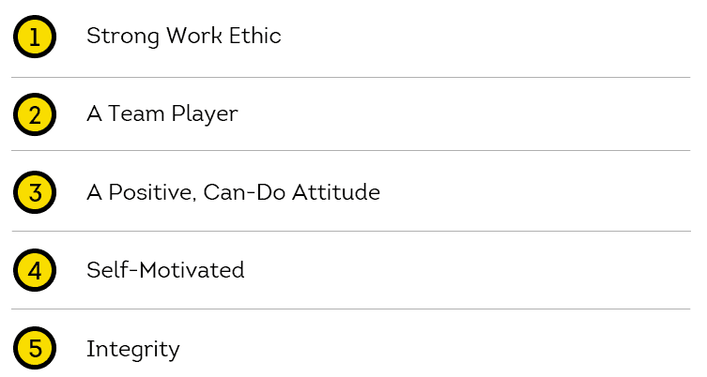
Top-5 Quantities of a Good Employee

Slide 6
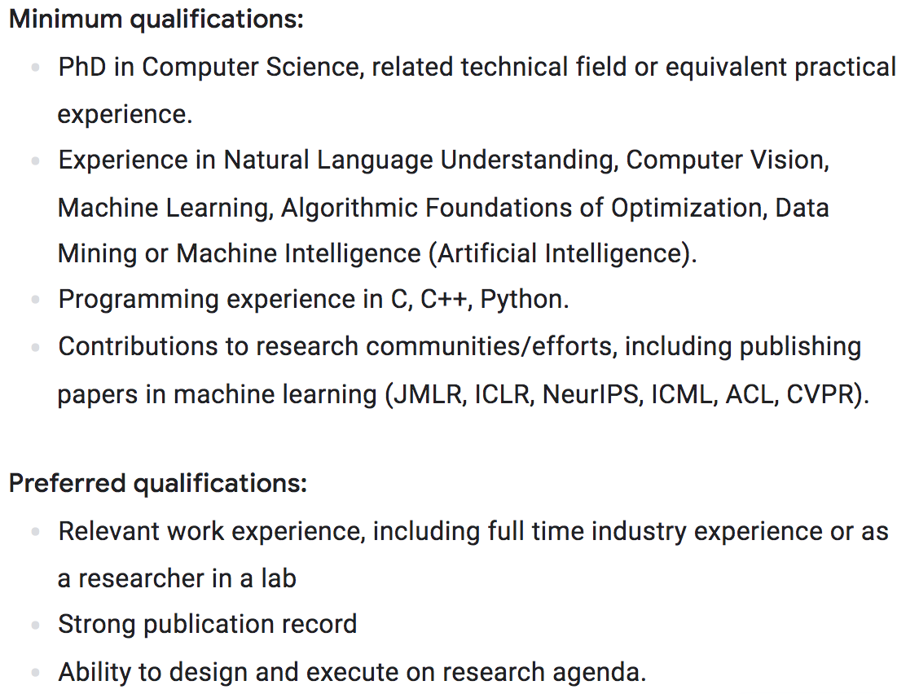
Example: Google’s Hire Post

Slide 7
Following the Five Steps
Step 1: Start with a gentle introduction
Step 2: Everyone talks about his/her idea
If your idea was used last week, don’t do it again; instead, listen to other members’ voice
Step 3: Identify 1—3 software-level challenges
For example, building intelligent navigation program
Step 4: Identify 1—3 hardware-level challenges
For example, finding a low-power drone engine
Step 5: Look for 1-2 people per level to hire
Application pool: https://github.com/tsung-wei-huang/cs3992/blob/main/resume/resume.md

